Slide 1
Unit3. Methods of estimation
Total Variation Distance, Kullback-Leibler (KL) divergence, and the Maximum Likelihood Principle
Describe properties of the total variation distance and Kullback-Leibler (KL) divergence .
Compute the total variation distance and KL divergence between two distributions.
Derive the maximum likelihood principle using the KL divergence.
Define and compute the likelihood of a discrete distribution.

Slide 2
Goal of next 5 lectures
How to construct estimators? Principled way of doing it
In previous lectures, we did by finding averages, or applying some functions to avgs such as using delta method
If the parameter how do we do?
Maximum likelihood estimation: a generic approach with very good properties
Method of moments: a (fairly) generic and easy approach (such as E[X] )
M-estimators: a flexible approach, close to machine learning, that focuses primarily on prediction

Slide 3
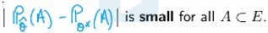
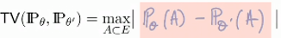
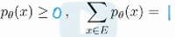
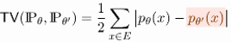
Total variation distance
Goal is to learn the underlying distribution
Let be a statistical model associated with a sample of i.i.d r.v. X1…Xn
Assume that there exists such that is true parameter
Statistician’s goal: given X1…Xn find an estimator such that
for the true parameter which means the following:
probability of all events under both distributions are similar
The total variance distance between 2 probability measures and is defined by worst deviation when we compute events under P theta
In a case of discrete distributions and
The total variation distance between and is a simple function of their PMFs:

Slide 4
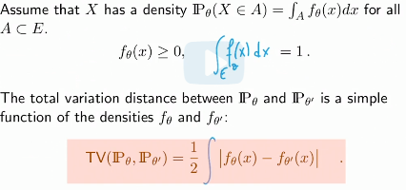
Total Variation Distance for Continuous Distributions
a

Slide 5
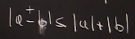
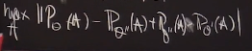
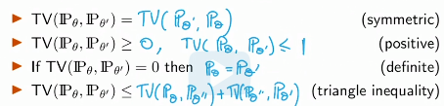
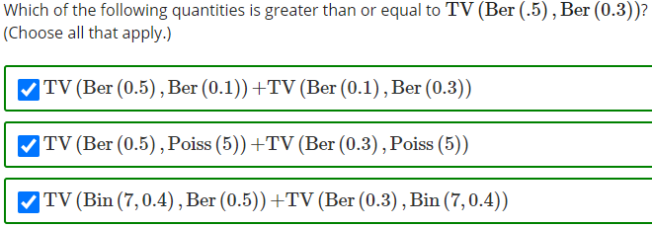
Properties of Total Variation Distance
Triangle inequality:
The last one is max of difference is less than difference of max’es
These properties imply that the total variation is a distance between prob distributions

Slide 6
Examples
A
Total variation distance is nice, but it does not capture the horizontal variations in support (like for both PDF and PMF if we switch horizontally little bit but do not intersect the 2nd distribution, then it again equals to 1)
Total variation distance between PDF and PMFs are also 1

Slide 7
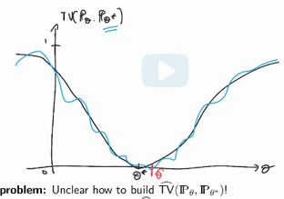
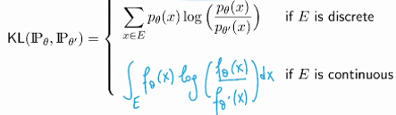
An Estimation Strategy and Definition of Kullback-Leibler (KL) Divergence
Our estimation strategy is to build an estimator and then find
Theta_hat that minimizes the function
We aim to estimate this function and minimize it
The problem is that it is unclear how to build this estimator
Then we say to build a method for estimation we need
To estimate something
Previously, we just took expected values of some parameters and they worked out well, now again if we can express this estimator function that is minimized at theta star as the expectation of something and then replace E[X] by avg, then we are good
Kullback-Leibler divergence (or relative entropy) between 2 probability measures
is defined by
https://www.wikiwand.com/en/Kullback%E2%80%93Leibler_divergence#/Definition

Slide 8
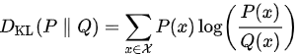
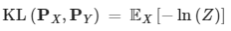
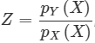
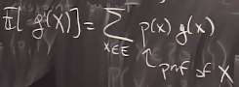
Kullback–Leibler divergence
In mathematical statistics, the Kullback–Leibler divergence (also called relative entropy) is a measure of how one probability distribution is different from a second, reference probability distribution
For discrete probability distributions P and Q, defined on the same probability space X, the Kullback–Leibler divergence from Q to P is defined to be
In other words, it is the expectation of the logarithmic difference between the probabilities P and Q where the expectation is taken using the probabilities P
The Kullback–Leibler divergence is defined only if for all x, implies

Slide 9
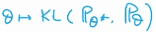
Properties of Kullback-Leibler (KL) Divergence
1) not symmetric
2) Non-negative
3) Definite
4) Doesn’t obey to triangle inequality
So, this is not a distance, but it is called a divergence
Asymmetry is the key to our ability to estimate it, theta_star as unique minimizer of
In general, it is very hard to compute the total variation between two distributions– even for two Gaussians this is a difficult computation. As a result, it is also difficult to build an estimator for total variation.
The KL divergence is easier to compute, and since it can be written as an expectation, we can estimate the KL by taking averages.

Slide 10
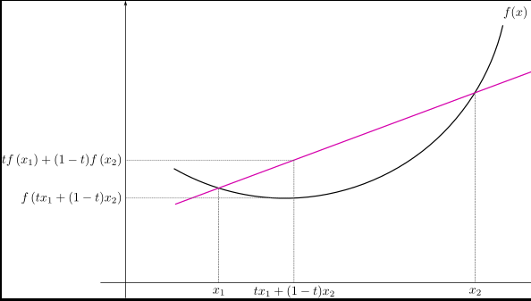
Jensen’s inequality
Secant line of a convex function lies above
the graph of the function, where secant line
consists of weighted means of the convex function
while the graph of the function is the convex function of the weighted means
Thus’ Jensen’s inequality is
In the context of probability theory

Slide 11
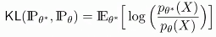
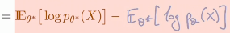
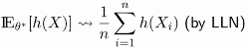
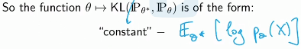
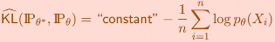
Estimating KL Divergence
So our primary aim was to find a parameter of distribution, so that we then determine the underlying distribution itself
First, we started with total variation distance, but then have seen that it has some undesirable properties ( 1) when we measure distance between PMF and PDF, 2) does not reacting to horizontal changes in parameters, 3) hard to compute), so we were in search of new technique for finding parameter of distribution, Kullback-Leibler
Having found new technique, we want to minimize this function and find unique theta*
So, now we need to find an estimator for KL and that’s what Max Likelih est is doing
c where E[X] can be estim
So, our estimate for KL div. is

Slide 12
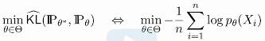
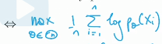
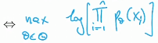
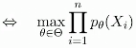
Deriving the Maximum Likelihood Estimator
So, starting from the beginning: 1) aim was to find underlying distribution and we said if we can find parameter of distrib then we are done 2) we found a function that characterizes the difference between 2 distributions 3) then we need to minimize this function and find the value of parameter where this happens
So, now our goal is to minimize the estimate for KL
Which is equiv. to which is maximum likelihood principle
Under certain technical conditions, the maximum likelihood estimator is guaranteed to (weakly) converge to the true parameter

Slide 13
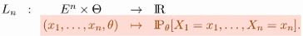
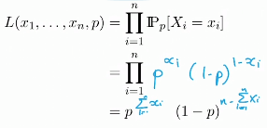
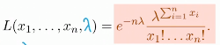
Likelihood of a Discrete Distribution
Definition: Likelihood of the model is the map (from given data X1…Xn and parameter theta to Probability) Ln defines as
A Poisson random variable takes values on all non-negative integers
A Poisson random variable is specified by its mean lyamda, which is allowed to be any positive real number

Slide 14
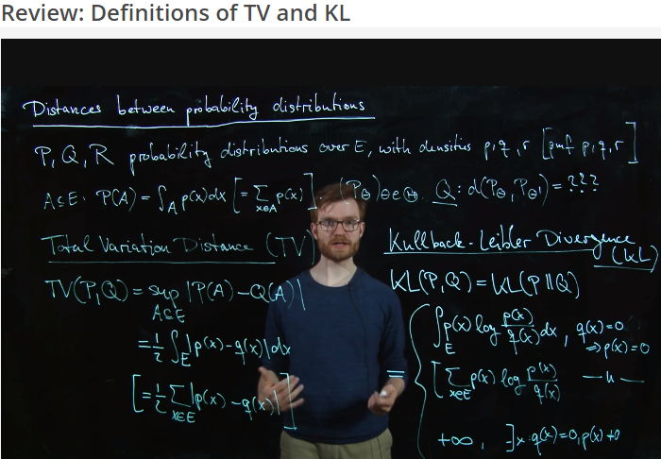
Recitation

Slide 15
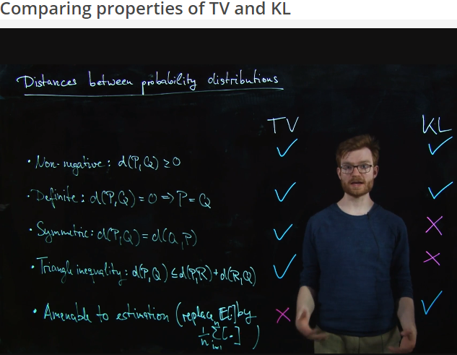
Recitation

Slide 16
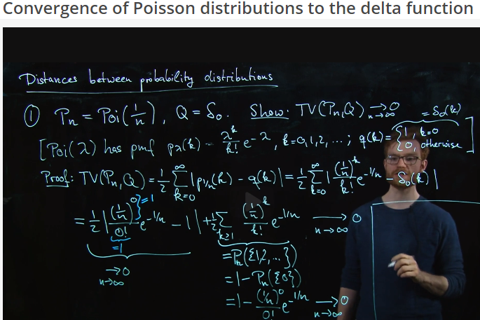
Recitation

Slide 17
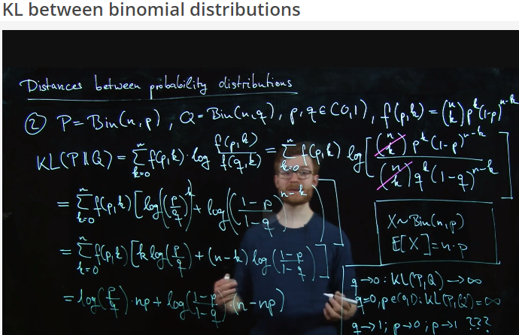
Recitation

Slide 18
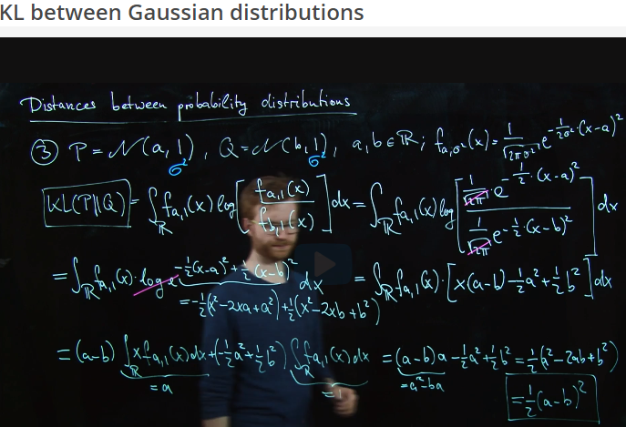
Recitation

Slide 19
Introduction to Maximum Likelihood estimation
Compute the likelihood of a continuous distribution .
Interpret the maximum likelihood estimator as the objective value of an optimization problem.
Define and compute the maximum likelihood estimator of an unknown parameter.
Maximize a strictly concave function in one, two, or more dimensions.

Slide 20
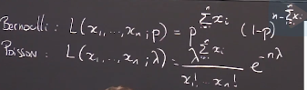
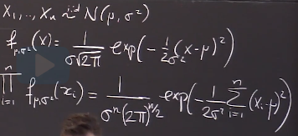
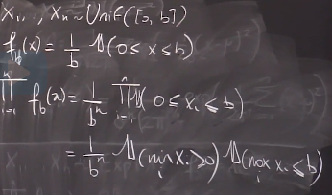
Likelihoods of distributions
We showed that essentially minimizing the estimate of the KL turned out to be exactly the same thing as maximizing so-called likelihood function, which is a function of observations and theta
Likelihood of a discrete statistical model is continuous

Slide 21
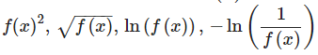
Maximum likelihood estimator
The arguments of the minima (or maxima) of a function f(x), denoted by argmin f(x), is the values of x at which f(x) is minimum (or max)
We can also restrict to a subset of the domain of f, and denote
The values of at which f(x) is minimum over S
Exercise let’s say value f(x) is continuous positive function, and as above functions are strictly increasing, inputting max value to them, will result in their max value, and thus their argmins will be the same
Whereas, cos(x) function is strictly decreasing in (0,pi). Given
Is in fact minimum when f(x) is maximum (like the larger input you give, less value you det

Slide 22
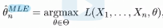
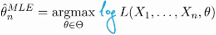
Maximum likelihood estimator
The maximum likelihood estimator of theta is defined as
provided it exists
Log-likelihood estimator is used more in practice
Maximizing an increasing function is the same as maximizing log (it is also an increasing function) of that function (in terms of argmax)
Maximizing a function is the same as minimizing the negative of that function (same argmax or min)
Maximization of arbitrary functions can be difficult (due to many local min/max es)
2 definitions for concavity: convex: synthetic (curve is below its cord) and analytical (2nd derivative is non-negative; derivative not decreasing)
A twice differentiable function is said to be concave if its 2nd derivative satisfies and it is said to be strictly concave if the inequality is strict

Slide 23
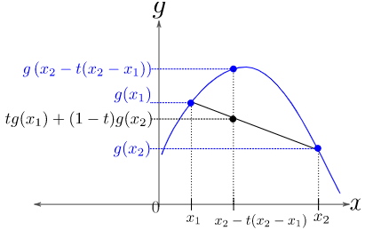
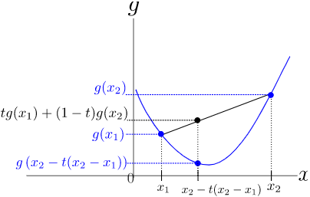
Concave vs convex
Function is concave on an interval I, if for all pairs of real numbers
which means value of function at intermediate input is greater than avg value of inputs on borders
Geometrically, this means that for the graph of g is above the secant line connecting the 2 points (x1,g(x1)) and (x2, g(x2))
Definition of convex is the opposite
Geometrically, this means that the graph of g is below the
Secant line connecting 2 points
Also, we have analytical definitions if g is twice differentiable

Slide 24
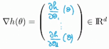
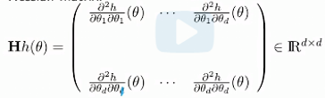
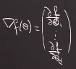
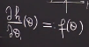
Concavity in Higher Dimensions: Gradients, Hessians, Semi-Definiteness
Gradient is an equivalent for the 1st derivative for multivariable functions
Hessian is an equivalent for the 2nd derivative for multivariable functions
More generally, for a multivariate function , d>=2, we have
Gradient vector Hessian matrix:
So, to be able to call the multivariable function h concave, we need to say that the entire matrix as a 2nd derivative is negative, and saying that all entries of this matrix is negative is not enough, because this means just along some axes, function looks like a dome, but the rest can be weird, so not enough, we want the whole function to look like a dome

Slide 25
Semi-definiteness
So, h is concave if any vector that we hit our matrix with gives non-positive number at all values of our function
Another definition of negative semi definite matrix is that all of eigenvalues of matrix H is nonpositive
If hessian is diagonal and its elements are all + or – then that is enough to say where function h is concave or convex
The 2nd rule is if all entries in the Hessian matrix are the same (+ or -) then again by just looking at it we can determine whether function convex or concave
If we have a linear function composed with an increasing and concave function, then we end up with something, which is increasing and concave
Sum of concave/convex function is concave/convex
Product of convex/concave functions is not necessarily concave/convex
(-1) *f is convex if f is concave and vice versa

Slide 26
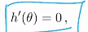
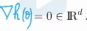
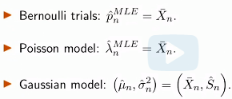
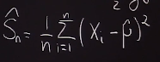
Strictly Concave Functions and Unique Maximizer
Why we opened a discussion on convex and concave functions is because previously we were talking about maximizing (ML) and minimizing functions (KL)
What is good with convex/concave functions is their min/max is achieved at exactly 1 place (unique) and essentially, these are functions, where local info translates into global information (if we wind a point where deriv=0, we don’t need to look elsewhere to find another min/max
Condition to find max/mins are

Slide 27
Lecture 10. Consistency of MLE, Covariance Matrices, Multivariate Statistics
Objectives
Derive the maximum likelihood estimator for the uniform statistical model and prove its consistency.
Recognize that the maximum likelihood estimator is consistent.
Know that independence implies zero covariance but not vice-versa.
Define sample covariance as an unbiased estimator for the covariance.
Obtain the covariance matrix of a random vector.
Identify multivariate Gaussian random variables and understand affine transformations of multivariate Gaussian random variables.
Use multivariate Central Limit Theorem .
Use multivariate Delta method .

Slide 28

Maximum Likelihood Estimator of Uniform Statistical Model
We usually found the maximum likelihood estimator by differentiating likelihood function and setting derivative to 0
We encounter problems when we have indicator function in likelihood function
For example, on the right for Uniform distrib
When lyamda<max(X) then likelih f=0
Taking deriv and setting it to 0 is true only when the
Function has derivatives everywhere
For example This function at lyamda=max(X) does not
Have derivative, instead based on plot we can see
Where the maximum is
So, regularity means that I can take deriv of my log likelihood and set it equal to 0 and get the maximum likelihood and the support of the distrib cannot depend on param
It is good to sanity check what we get as answer when we get non-traditional estimator that doesn’t depend on Xn; like when estimating lyam in U(0;lyam) as max(X)

Slide 29

Consistency of the Maximum Likelihood Estimator
We might question whether MLE is actually a good estimator? Is it unbiased, does it have small variance, does it have a small quadratic risk, is it consistent, is it asymptotically normal?
So, why will it be a consistent estimator? Well, it is not completely obvious
At some point, we replaced an expectation by avg when we were on our way to compute the MLE
Now, as soon as we replace E[X] by an average under mild conditions we have law of large numbers that tells us that averages converge to expectation
So maximizing likelihood function is minimizing –KL function , where P_theta star minimizes the KL and given theta_star is identifiable, P_theta star uniquely identifies theta_star that minimizes the KL
So, Convergence of KL function (difference between distributions) transfers to convergence of parameters of distributions (theta’s) - minimizers

Slide 30







Multivariate random variables
Given i.i.d samples and an associated statistical model
The ML estimator is a consistent estimator under mild regularity conditions (e.g. continuity in theta of the pdf p_theta almost everywhere)
This is also true even if the parameter theta is a vector in a higher
Dimensional parameter space and is a multivariate random variab e.g.
Multivariate random variable, or a random vector, is a vector-val.
Function whose components (scalar) are random variab on the same underlying prob. Space vector of dim d*1 is a vector-val function from a prob. Space
Probability disrib of a random vector X is the joint distrib of its comp. X(1)..X(n)
CDF of a random vector X is defined as
Conv in prob in higher dimen is no more than conv in prob for each component

Slide 31


Asymptotic normality and covariance
Now, we want to talk about asymptotic normality
When our random variable is a vector, to make sure that it is asymptotically normal we need all of its components to be asymptotically normal, and also take into consideration the interaction between them through the covariance, in general the coordinates of random vector are not necessarily independent
covariance is a measure of the relationship between two random variables
how much – to what extent – the variables change together
Positive (resp. negative) covariance: Indicates that two variables tend to move in the same (resp. opposite) direction
Using covariance, we can only gauge the direction of the relationship (whether the variables tend to move in tandem or show an inverse relationship). However, it does not indicate the strength of the relationship, nor the dependency between the variables.
Correlation measures the strength of the relationship between variables. Correlation is the scaled measure of covariance. It is dimensionless.

Slide 32
Covariance equation and properties
Cov(X,Y)=E[(X-E[X])*(Y-E[Y])]=E[XY]-E[X]*E[Y]
Cov(X,a)=0
Cov(X,X)=var(X); Cov(X,Y)=Cov(Y,X)
Cov(aX,bY)=ab*Cov(X,Y)
Cov(X+a,Y+b)=Cov(X,Y)
Cov(aX+bY,cW+dV)=ac*Cov(X,W)+bc*Cov(Y,W)+ad*Cov(X,V)+bd*Cov(Y,V)
If X and Y are indep. Cov(X,Y)=0; converse is not true except if a random vector (X,Y)’ is a Gaussian vector, that is not only components of vector are both Gaussian but also any linear combination of components is also Gaussian - Gaussian for all

Slide 33


Covariance matrix
When we have more than 2 random variables we can talk about covariance matrix
The covariance matrix of a random vector is given by

Slide 34

Multivariate Gaussian Distribution
Gaussian r.v. is described by only 2 parameters, mean and variance, whereas the multivariate Gaussian is determined only by multivariate mean and multivariate covariance matrix (so 1 mean vector and 1 covariance matrix)
If (X,Y)’ is a Gaussian vector then we need 5 parameters to describe its pdf, namely E[X], var(X), E[Y], var(Y), cov(X,Y), that is Gaussian vector is determined by only
Here myu is expected value vector and sigma is covariance matrix
So, that after knowing expectation vector and covariance matrix we can write PDF, which is:
A random vector X=(X1,…,X(d))’ is a Gaussian
Vector or multivariate Gaussian, if any linear combination of its components is a Gaussian variable or a constant (a Gaussian variable with 0 variance)
If expectation vector=0 and covariance is the identity matrix, then X is called standard normal random vector, and when the covariance matrix is diagonal, the pdf factors into pdfs of univariate Gaussians, and hence the components are independent

Slide 35



Multivariate Central Limit Theorem
The CLT may be generalized to averages of random vectors
Let X1,…,Xn in Rd be independent copies of random vector X such
Then we have or equiv.
Any covariance matrix is a positive definite matrix
Convergence in distribution in higher dimensions
Convergence in distribution of a random vector is not implied by convergence of each of its components
A sequence T1, T2… of random vectors in Rd converges in distrib. to a random vector T if
That is, the vector sequence Tn converges in distribution only if its dot product with
any vector v, which is scalar r.v. converges in distribution (equiv., if the projection of the vector sequence onto any line converges in distribution)

Slide 36


Multivariate CLT
Let X1,…Xn be i.i.d random vectors in Rd with mean and cov matrix
Let and define Then Yi is a scalar random variable with mean and variance Hence, Yi satisfied univariate CLT:
On the other hand, consider a multivariate Gaussian r.v.
For any constant vector is a univariate Gaussian with var
Hence, , which is the distrib above, therefore Xn conv. In distribution

Slide 37








Multivariate Delta method
Let Tn be a sequence of random vectors in Rd such that
for some and
Let g be function from Rd to Rk be cont diff at theta
Then Where
This is also a transpose of Jacobian

Slide 38
Fisher information
But we do not need to just convergence when we have sample mean or some function of it, we want to have a general method such as in Maximum Likelihood estim
We define the log-likelihood for 1 observation as:
We assume that l (log likel) as twice differentiable and under some regularity conditions, the Fisher information of the statistical model is defined as:
If theta is 1 dimensional then we get:
So, if we look at the covariance matrix of the gradient, we end up with – E[hessian]
When we change the parameter value theta, what actually changes is the probability distribution of the data. The changes in the parameter are somewhat artificial, meaning that param is just a device to describe the model. The changes in the prob. Distr are essential because these are reflected in the data. So, changing the parameter value by a lot is meaningless, whereas changing the prob distr by a lot is meaningful since we will detect this in the data. The Fisher info matrix is a tool to quantify the effect of a small (infinit) change in the parameter value on the change in the prob distr of data. It tells us how easy/hard is it to distinguish different values of the param based on random sample from the corresponding changes in the probability distribution

Slide 39

Consistent estimator of the variance
So, steps for finding a confidence interval are:
1) Find an estimator for the parameter of interest via some properties/equations of that parameter
2) Determine the asymptotic distribution of estimator
3) Construct the conf. int
To check the consistency of estimator we need to analyze to what distrib convergence in prob when n goes to inf, whereas bias is determined by E[est]- E[par]

Slide 40

Applying the Multivariate Central Limit Theorem
Here we cannot just apply the CLT to individual components, because then we disregard the interaction between the random variables
To account for interaction in joint distribution, we can apply multivariate CLT
Then we need to combine the terms to the get the final answer

Slide 41


Applying the Multivariate Delta Method
a

Slide 42

Confidence Interval

Slide 43
Lecture 11: Fisher Information, Asymptotic Normality of MLE; Method of Moments
Objectives
Compute the Fisher information of a statistical model.
Compute the asymptotic variance of the maximum likelihood estimator.
Use the method of moments to estimate parameters in a statistical model.
Describe conditions under which the method of moments succeeds.
Use the delta method to compute the asymptotic variance of the method of moments estimator.
Compare and contrast the maximum likelihood estimator and the method of moments

Slide 44


Fisher information
log likelihood is a random function (depending on realization of X and also it is function of theta. It is simply PMF or PDF
If theta is in Rd, that is, it is a multivariable function of d dimension, then we can talk about the gradient of l(theta), so gradient of likelihood function then is a random vector with elements as dl/d theta1; dl/d theta2 etc
If gradient of l is a random vector then we can think about its covariance matrix
https://www.quora.com/What-is-an-intuitive-explanation-of-Fisher-information
If we assume that l is twice differentiable, under some regularity conditions, the Fisher information of the statistical model is defined as covariance matrix of gradient of loglikelihood function (which is random vector)
RHS is Hessian of l(theta)- matrix of 2nd derivatives

Slide 45



Fisher information
We have a random vector, elements of which are derivatives of l(theta) likelihood function wrt to theta1,2…
Fisher information of a statistical model is then a covariance matrix of gradient of log likelihood function, like elements of Fisher information or covariance matrix are variances of dl/dtheta1, dl/dtheta2… and cov(dl/dtheta1, dl/dtheta2)…
We have an alternative formula for Fisher information
So, now we want to prove the equality
Using the 1) definition of expectation, 2) interchange of derivatives and integrals and 3) the fact that integral of f(theta) integrates to 1, we get that var(l’(theta))=-E(l’^2(theta))
now we stop here and start simplifying the RHS
In RHS we expand the expression using definition of expectation and then reach the same exp as in LHS

Slide 46
Intuitive explanation of Fisher information
What does the Fisher Information seek to measure?
Let’s a r.v. X and a parameter theta are related with some density function
The Fisher info answers the question: How useful is the r.v. X in determining the unknown parameter theta, if r.v. has a lot of info regarding theta, then it is useful for locating value of parameter

Slide 47

Fisher Information of the Bernoulli Random Variable
2 ways of computing the Fisher information: 1) that is to compute the 2nd derivative and take its expectation and put – sign in front 2) find the 1st derivative and compute its variance
For a random vector case, rather than just random variable, we have
So, here we compute 1)log likelihood 2)then Hessian based on parameters of likelihood function 3) find – expected value of Hessian
Fisher information, which is equal to tells us how curved on average the log likelihood function is
In particular, tells us how curved (on average) the log-likelihood is near the true parameter, as a rule of thumb, if the Fisher info is large, the we expect the MLE to give a good estimate for theta*

Slide 48

Asymptotic normality of the maximum likelihood estimator
Fisher information is controlling the asymptotic covariance matrix of MLE
We are trying to say that if some conditions are satisfied, MLE will have an asymptotic normality using CLT
Let we assume the following:
The parameter theta is identifiable
For all , the support of does not depend on theta
Theta* is not the boundary of theta, because then we can’t differentiate
is invertible in a neighborhood of theta*
A few more technical conditions
Then satisfies
https://rpsychologist.com/d3/likelihood/

Slide 49




Moments: definitions
Let X1,…,Xn be an i.i.d sample associated with a statistical model
We assume that
Then population moments are defined as:
Empirical moments:
From Law of large numbers
More compactly we say that the whole vector converges
Function M maps from inputs (mu and sigma) to moments and if we have this function we can also go back from moments to inputs by solving system of equations

Slide 50


Moments estimator
Now we discuss the moments estimator
we have theta in Rd
and our moment vector is as shown from the 1st moment to d’s moment
We assume that M (function) is one to one
Then definition of moments estimator of theta is
Provided it exists
That is just an inverse map, from empirical moments
So, idea of moments estimator is to compute moments (sample moments), then invert the function that maps from parameters to moments, to find estimates for parameters

Slide 51




Generalized Method of Moments Estimator: Statistical Analysis
Function M
Estimate for M
To use CLT we need also covariance matrix
For delta method we need also
We have CLT shown on the right, but in reality we need to apply M^-1 function to CLT so that we get theta

Slide 52



Generalization of the method of moments
a

Slide 53
MLE versus Method of Moments
So, it is only (both are unbiased) a matter of variance and there is actually a lower bound called the Cramer-Rao lower bound that states that for no unbiased estimator may have an asymptotic variance or even variance which is smaller than the inverse Fisher information (which is asymptotic variance of the MLE), so MLE is optimal
So, overall MLE vs Method of moments
To compare MLE vs Method of moments we can use quadratic risks (combination of bias and variance) , and in general, MLE is more accurate
MLE still gives good results if model is misspecified
Computational issues: sometimes, the MLE is intractable but MM is easier (polynomial equations). Hard to find max of likelihood function
MM requires us to find d, so that 1st d moments uniquely determine the distribution of interest. For MLE we don’t need that. The expression of moments map in terms of the parameter theta can be quite complicated, so it may be difficult to deduce how many moments (degrees of freedom) are needed to uniquely recover the true distribution from moments

Slide 54
Miscellaneous
while doing a Maximum Likelihood Estimation, if I use an exponential model for a Gaussian model ( true model), would MLE still give me a good result?
In the case where the model is not well-specified (misspecified), then the MLE identifies that probability distribution in the model, that minimizes the KL divergence to the true probability distribution of the data.

Slide 55

Recitation: Maximum Likelihood Estimator for Multinomial
Overview of Estimation and hypothesis testing, or generally statistical inference: 1) Collect the data about the process you are interested in 2) Assume the model that generates the data 3) Apply MLE or M method to estimate the parameter of interest for the parameter 4) Find variance/covariance matrix depending whether it is single parameter or multiple parameters 5) Either construct a confidence interval for the estimate or for hypothesis testing

Slide 56

Recitation: Maximum Likelihood Estimator for Multinomial

Slide 57

Recitation: Maximum Likelihood Estimator for Multinomial

Slide 58

Recitation: Maximum Likelihood Estimator for Multinomial

Slide 59

Recitation: Maximum Likelihood Estimator for Multinomial

Slide 60

Recitation: Maximum Likelihood Estimator for Multinomial

Slide 61
M-estimation
Objectives:
Understand the formulation of M-estimation as a generalization of the MLE
Define an M-estimator for the mean, median, and alpha-quantile of an unknown distribution
Find the asymptotic variance of an Ь-estimator
Define what the Cauchy distribution is
Apply Huber’s loss to the Laplacian distribution

Slide 62


M-estimators
Idea:
Let X1,…,Xn be i.i.d with some unknown distribution P in some sample space E (where E is the set of values that X1,…,Xd takes)
No statistical model needs to be assumed (similar to machine learning)
Goal is to estimate some parameter myu* associated with distribution P, its mean, variance, median, other quantiles, the true parameter in some statistical model
The goal is to find a function (where M is the set of all possible values for the unknown mu*, (2 inputs to function rho: 1) values that r.v. X takes and 2) values that parameter takes) such that achieves its minimum at
So, function rho is similar to log-likelihood that 2 parameters x and theta

Slide 63

MLE is also M-estimator
We assume that is a statistical model associated with the data
Theorem
Let , provided the likelihood is positive everywhere, then

Slide 64
Statements about M-estimation
"M-estimation involves estimating some parameter of interest related to the underlying, unknown distribution (e.g. its mean, variance, or quantiles)" is correct. This is precisely the goal of M-estimation, It is a flexible approach that applies even outside of parametric statistical models.
"Maximum likelihood estimation is a special case of M-estimation." is correct. If we set the loss function to be the negative log-likelihood, then the same optimization problem defining the MLE is the one considered for the M-estimator associated to this loss function.
"Unlike maximum likelihood estimation and the method of moments, no statistical model needs to be assumed to perform M-estimation." is correct. As stated above, M-estimation is a flexible approach that can used to approximate relevant quantities of interest to a distribution, such as its moments.
"M-estimation cannot be used for parametric statistical models." is incorrect. M-estimation can be used in both a parametric and non-parametric context, though in this lecture, we will only see it applied in parametric examples.

Slide 65
M-estimation
Let X1,…,Xn be i.i.d with some unknown distribution P and an associated parameter mu* on a sample space E. We make no modeling assumption that P is from any particular family of distributions
An M estimator is the argmin of an estimator of a function
Of the parameter which satisfies the following:
for some function where M is the set of all possible
Values of the unknown parameter
2. Attains a unique minimum at in M. That is,
In general, the goal is to find the loss function rho, such that has properties stated above
Note that the function is in particular a function of r.v. X, and the expectation in
is to be taken against the true distribution P of X, with assoc parameter
Because is an expectation, we can construct a consistent estimator of by replacing the expectation in its definition by the sample mean

Slide 66




Ideas for M-estimation
MLE strategy: M-estimation strategy
is minimized at some theta=theta*
KL divergence= -E[loglikel]+ const; or - + const
To minimize KL div we need to maximize loglikelihood
Now, we want to talk about asymptotic normality of M
So, we need to talk about asymptotic variance and delta method
So we have 2 new quantities

Slide 67





J and K matrices
Asymptotic variance
When rho is loglikelihood

Slide 68

Asymptotic normality

Slide 69




Robust statistics, Cauchy distribution
Robust statistics is statistics that is not affected by outliers (median vs avg)
In Cauchy distribution the tails are heavy, so with every realization there is a lot variation in x’s, and we do not have E[X] and var(X)
In cases when we can’t use mean, we can use median as
As an estimator for example for m

Slide 70






Robust estimators
For estimating parameter m of Cauchy distribution we can use median as estimator, but to use CLT we need to be able to differentiate parameter and talk about 1st, 2nd derivatives
So, we fail.
We can overcome this problem, if we will define a loss function that’s going to give us some robustness, but it also going to allow us to have the smoothness properties that we want
We replace abs(x) function with ½*x^2 at point x=0
Our function is 1) ½*a^2 when abs(a)<sigma 2) otherwise

Slide 71




Applying Huber's loss to the Laplace distribution
a

Slide 72


Applying Huber's Loss to the Laplace distribution (Continued)
Now that we have asymptotic variance
We can apply the CLT
Variance is a function of delta

Slide 73
Recap
We essentially saw 3 principal methods (MLE; method of moments; M-estimation) for estimation and 1 non principal (if your parameter is an expectation just find it by taking sample average)
MLE is about maximizing likelihood function, finding parameters that maximize the probability of observing data, which is a special case of M-estimation
Method of moments- says like I have parameters, they give some moments, given the values of moments we can use inverse function of parameters -> moments to invert back to parameters (for ex. M1=a+b; M2=a*b, so given M1 and M2 we solve system of equations to find a and b)
All methods yield to asymptotic normality under regularity conditions (MLE is easiest since expectation of 2nd derivative of loglikel and variance of 1st derivative are equal to Fisher information (2 definitions for Fisher info), so nice cancellation)
For all 3 methods asymptotic covariance matrix can be computed using multivariate delta method
Once we have asymptotic variance, we can build Conf interval and do hypothesis test

Slide 74

Recitation. M-estimation
Here, we want to show that distribution of estimator of median is normal
Goal of recitation – review what is M-estimation and compare diff estim through asym var

Slide 75


Recitation. M-estimation
Asymptotic variance of median comparing M estimators for median and mean Lap dist

Slide 76


Recitation. M-estimation
Asymptotic var of mean vs median for Cauchy. Asymp var of Huber estim under Cauchy distr

Slide 77


Recitation. M-estimation
Calculation of asymp var using Huber loss. So when delta-0 –median; inf-mean that is when delta=0 more like abs(x) vs inf like x^2

Slide 78


Recitation. Mean squared errors
Shrinkage estimator (introduce little bit bias error but decrease more var error, so overall less total error MSE for estimators of Poisson random var.

Slide 79


Recitation. Mean squared errors
MSE for uniform random var. As n->inf MSE for 2nd estimator << 1nd estimator

Slide 80


Recitation. Mean squared errors
MSE comparison for 2 unbiased estim Shrinkage estim (biased estim but smaller var)

Slide 81

Recitation. Multivariate Gaussian
Here, we define joint PDFs for bivariate and multivariate Gaussians (rho-cor coeff and cov matrix is used to give info about interaction

Slide 82

Recitation. Multivariate Gaussian r.v.
Marginal PDF of normal r.v. from joint PDF

Slide 83


Recitation. Multivariate Gaussian
Covariance of X and Y Finding joint PDF of 2 r.v.

Slide 84

Recitation. Method of moments
Finding moments of Gamma distribution by using moment generating functions

Slide 85


Recitation. Method of moments
Using method of moments for a and b

Slide 86
Overview of units 1,2,3
Unit 1: Introduction to statistics
Lecture 1: What is statistics
Lecture 2: Probability redux
Unit 2: Foundations of inference ( estimation, confidence intervals, hypothesis testing)
Lecture 3: Parametric Statistical models
Lecture 4: Parametric estimation and confidence intervals
Lecture 5: Delta Method and confidence intervals
Lecture 6: Intro to hypothesis testing, type 1 and type 2 errors
Lecture 7: Levels and p-values
Units 3: Methods of estimation
Lecture 8: Total variation distance, Kullback-Leibler divergence
Lecture 9: Introduction to MLE estimation
Lecture 10: Covariance matrices, Multivariate Statistics and Fisher information
Lecture 11: Method of moments
Lecture 12: M:estimation

Slide 87





Key equations for unit 1
Law of large numbers: sample mean -> E[X] as n grows
CLT: properly scaled sum of i.i.d. r.v is normal r.v.
Hoeffding’s inequality, when n is not large enough to apply CLT
Markov’s Chebyshev’s ineq
Addition, multiplication and division of r.v. is possible if distribution is converging in probability; if in distrib we can use Slutsky’s theorem, one of distrib conv to number
Continuous mapping theorem: if f is continuous function, f(X)=f(Xn)

Slide 88





Unit 2 review
Trinity of statistical inference: estimation, confidence intervals, hypothesis testing
Goal of statistics is to learn the distribution of X based on a lot of data, prob is reverse
Definition of statistical model; types of statistical models (param, non-param, semi-param; identifiability of parameter of a statistical model, def of statistic, estimator
Jensen’s inequality: if function f() is convex then E[f(x)]>=f(E[X])
Bias and variance of estimator:
Consistent estimator is the one that conv to true parameter as n -> infinity
CLT: Confidence interval: mu^+/- q*std/sqrt(n)
4 options to replace var of pop in conf int: 1) sample var 2) solve eq 3) an exp 4) cons b
Delta method
Procedure for constructing a CI: 1) determine parameter of interest (mu, var etc) 2) come up with estimator 3) find asymptotic var (use CLT) 4) Construct CI

Slide 89

Unit 2 review continued
Procedure for hypothesis testing: 1) formula a question as a test, by specifying null (decide whether to do 1 sided or 2 sided tests) and alternative hypothesis (conditions for test 2)
Assumptions for hypothesis test: 1) model generating PDF 2) 1 vs 2 sided test
Definitions for terms in HT: 1) type 1 error- H0 is true but we reject 2) type 2 error- H1 is true but we reject 3) Power of test: 1- type 1 error (worst case alpha) 4) Level of a test: worst case alpha 5) test statistic – indicator function deciding whether we should reject or accept null 6) rejection region - set of all X’s that lead to rejection of H0 7) p-value: without specifying alpha, finding probability of observing particular X

Slide 90


Unit 3 review
Total variation distance
KL divergence
Min(KL)=max MLE
Semi-definiteness (required for concavity)
Multivariate CLT here X, mu are vector and we have cov matrix
Multivariate delta method
Fisher information is needed to computer asymp var of MLE
CLT for MLE estimator
Method of moments
MLE vs MoM
1.MLE is more accurate
2. MLE gives good results of model is misspec 3)easy computation for MoM, but diff map (M-1)

Slide 91





Unit 3 review continued
In M-estimation, the goal is to find the minimizer mu*
In M-estimation no need to specify model, we need to specify function and based on function we find mean, median and quantile
Asymptotic normality for M-estim
Huber Loss function for abs(x)
Mean sq. error
Theorem for MLE (CLT form) applies when 1) parameter is identifiable 2) Fisher information is invertible 3) support of PDF does not depend on parameter of PDF
Asymptotic variance of MLE and Method of moments estimator is the same

Slide 92
Midterm 1
ALL MLE estimators are asymptotically normal? –they are normal if certain technical conditions are satisfied. One technical condition that is often violated is that the support of the distributions depend on the parameters being estimated e.g. estimating theta when X1…Xn come from Unif[0,theta]
Confidence interval should not include the parameter itself (Ber(p) and it includes p)
Sample space of a statistical model E should not depend on its parameter
Fisher information is only computed for n=1

